Slide 1
Smart Phone Sensor Mining Applications: Ubiquitous Possibilities
A tutorial
Slides available from: http://storm.cis.fordham.edu/~gweiss/presentations.html
Gary M. Weiss
Fordham University
gweiss@cis.fordham.edu
storm.cis.fordham.edu/~gweiss

Slide 2
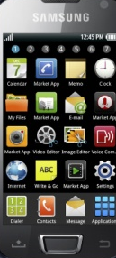

What is a Smart Phone?
A smart phone is a ___________ (think about separate devices it can replace)
Mobile “phone”
Internet connected computer (web, email, etc.)
Music device (MP3 player)
Gaming device
Camera & video recorder
PDA: calendar, address book, etc.
GPS-enabled map and guide
Sensor array

Slide 3
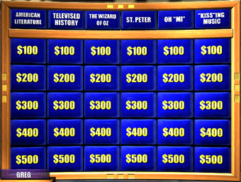
Guess the Sensors
What sensors are found on smart phones?
Audio sensor (microphone)
Image sensor (camera, video recorder)
Location sensor (GPS, cell tower, WiFi)
Proximity and motion sensor (infrared)
Light sensor
Tri-Axial Accelerometer; Gyroscope
Magnetic field sensor/compass
Temperature and humidity sensor
Pressure sensor (barometer)
Heart Rate Sensor (separate light sensor on Samsung S5)

Slide 4
Other Mobile Devices with Sensors
Tablets have some of the same sensors
Not as ubiquitous or accessible
Smart Watches much more relevant
Extension of the smart phone (not standalone)
Contain tri-axial accelerometer
Specialized sensors like heart rate sensor
Big advantage:
Worn in consistent on-body position (women don’t wear phones)
Disadvantage:
Not ubiquitous: not known how common they will be

Slide 5
Data & Sensor Mining
Data mining: application of computational methods to extract knowledge from data
Most data mining involves inferring predictive models, often for classification
Sensor mining: application of computational methods to extract knowledge from sensor data
Smart phone sensor mining: …
This tutorial does not focus on mining methods
Since the methods are not unique to sensor mining

Slide 6
Goals for this Tutorial
Provide basic introduction to the area
Taxonomy of the work that has been done
Highlight some of the many applications
Encourage/motivate/promote R&D
Creative applications waiting to be discovered!
Identify challenges and opportunities
Highlight relevant engineering issues

Slide 7
Who Might be Interested?
This tutorial will not be overly technical and should be of interest to a wide audience, including those interested in:
Expanding their use of data mining
Expanding use of sensors
Mobile communications and ubiquitous computing
Interesting software apps and impacting the world (and perhaps getting rich)

Slide 8
A Little Bit About Myself …
Previous research focused on fundamental issues related to data mining (class imbalance)
While important, not so interesting to students and little immediate, visible impact on the world
Six years ago started what is now WISDM (Wireless Sensor Data Mining) Lab
Research on activity recognition, biometrics, and mobile health apps
Flagship product is the actitracker activity recognition app (actitracker.com)

Slide 9
Tutorial Overview
Sensors, System Issues, and Platforms
Activity Recognition: Methods and Results
Applications
Activity Recognition/Fitness
Security Concerns

Slide 10
Sensors, Resource Usage, Architecture, and Platforms
A Whole New World …

Slide 11
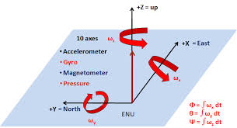
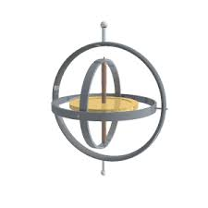
Sensors

Slide 12
Sensors
Tri-axial accelerometer
Present in virtually all smart phones and smart watches
Gravity is included
On Android & iOS default range is +2g to -2g
Can opt for bigger range at cost of lower resolution
Axes are fixed relative to phone and hence changes as phone shifts
Sampling rates 20-50 Hz
Study found 20Hz required for activity recognition⁴
We found could not reliably sample beyond 20Hz¹⁸
Uses:
originally mainly for game play and shifting display orientation
Now used for activity recognition & fitness apps

Slide 13
Sensors (cont.)
Gyroscope
Determines position and orientation of device
Measures rotation in radians/sec about each axis
Sensitivity to rotation is more robust to motion than accelerometer
Uses
Compasses and navigation
Recognition of spatial motions and gestures

Slide 14
Sensors (cont.)
Barometer (Pressure Sensor)
Measured in millibars
Uses:
Determine height and changes in height
Can tell if walking up or down hill; climbing up or down stairs
Can adjust calories burned based on associated effort
More accurate and localized weather prediction

Slide 15
Sensors (cont.)
Light Sensor
Measured in Luxes
Uses:
automatically adjust device display brightness
Virtual proximity sensor: sense “head” and turn off screen

Slide 16
Sensors (cont.)
Proximity Sensor and Motion Sensor
Measured in centimeters
Uses
Can be used to recognize gestures w/o touching phone
Phone turns display off when placed against ear

Slide 17
Sensors (cont.)
Location Sensors
GPS
Accurate to 10ft radius
Cell Tower Triangulation & Wifi
Less power required than GPS
Cell tower-based location not as accurate
Can improve speed of GPS lock and WiFI can improve accuracy of GPS
Uses:
Navigation, context awareness (location)

Slide 18
Sensors (cont.)
Magnetic Field Sensor
Measured in microteslas (per axis)
Uses:
Compass
Potential for use in metal detection
Humidity Sensor
Track weather and building conditions (especially if multiple users)

Slide 19
Sensors (cont.)
Heart Rate Sensor (Samsung Galaxy S5)
Can simulate with camera by changing in color on finger tip
Will be included on smart watches
Uses:
Fitness applications
Monitor stress levels

Slide 20
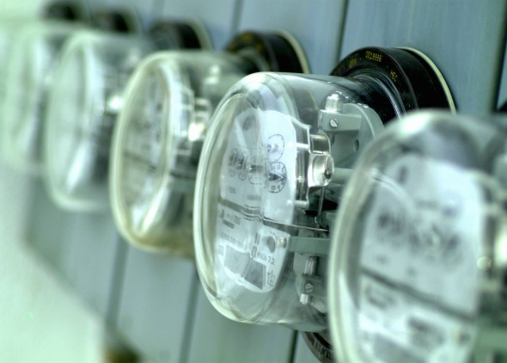

Resource Usage
Battery Life, RAM & CPU
“Smart phone sensor mining is NOT the phone’s main priority and this sometimes becomes very evident” – Gary Weiss (2011)
“Continuous sensor mining is becoming common, a more central task as mHealth apps proliferate, and the phones are adapting” –
Gary Weiss (2014)

Slide 21
Sensors and Battery Life
Continuous monitoring of sensors was either not considered or viewed as secondary
Example: Android hibernation is key to saving power, but puts sensors to sleep!¹⁸
Work around involved preventing hibernation but turn screen off (but CPU still awake)
Now recognized sensors need to run continuously
Apple M7 motion coprocessor introduced in 2013
Still cannot always monitor sensors in low power mode

Slide 22
Power Consumption
GPS localization take lots of power
Turn off GPS when not needed/when inside²³
uses cell towers not GPS to determine when go outside
Sample at lower rate if acceptable to application
But because GPS lock takes time (~1 min) and energy, small reductions in high sampling rates not helpful

Slide 23
Power Consumption
Uploading data can take significant power
Upload via cellular network takes even more if cell phone tower is far away
WiFi takes less power than cellular
If transmission not time-sensitive then store and send
Actitracker and many other apps let you set your preferences (e.g., WiFi only)

Slide 24
Power Consumption for WISDM¹⁸
Activity | Power (Watts)
Android | 0.001
Sensor Collector | 0.043
Lit up Screen | 0.525
Battery Test on HTC EVO with GPS off
Sensor Collector is WISDM App to collect and store sensor data, but does not apply predictive models to it.
Sensor collector has minimal impact on battery life, thus it is feasible to continuously collect sensor data.
When device on idle, SensorCollector takes 6.6% of power

Slide 25
Power Consumption Nokia n95²³
Activity | Power (Watts)
Phone Idle | 0.054
Accelerometer Sampling (32 Hz) | 0.111
GPS Assisted Lock | 0.718
GPS Lock | 0.407
GPS Sampling (1 Hz) | 0.380
Music Player | 0.447
Video Player (Screen on) | 0.747
Active Call | 0.603
Gaming (Screen On) | 1.173
Generating Features & Executing Classifier | 0.003
App to Determine Transport Mode | 0.425

Slide 26
Resource Issues Summary
In almost all cases power is much more of a limiting resource than CPU or RAM
Typical sensor mining apps might drain the battery in 8-12 hours
Not acceptable for apps that run continuously
We need to work hard to only use power when needed (adaptively)

Slide 27
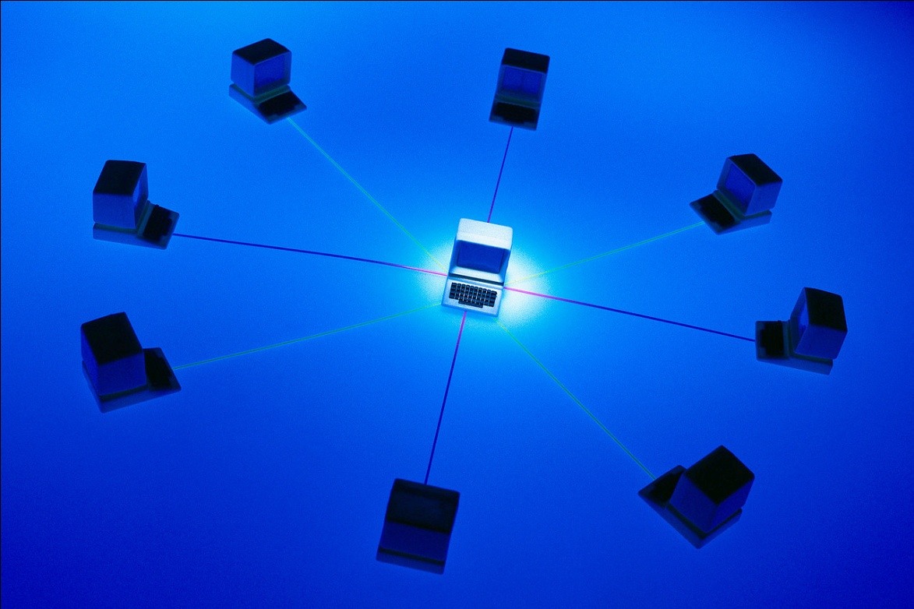
Client vs. Server Responsibilities

Slide 28
Division of Client and Server Tasks
Division of labor has tradeoffs
More processing on client means:
Application/platform more scalable
Increased privacy
Bigger drain on power, CPU, & RAM, but not bandwidth
More processing on server means:
Data captured for future research and other uses
Can exploit data not otherwise available (crowdsourcing)
Example: Google Navigation

Slide 29
Division of Client and Server Tasks
Client Type: | 1/Dumb | 2 | 3 | 4 | 5 | 6/Smart
Data Collection | • | • | • | • | • | •
Data Transformation |  | • | • | • | • | •
Classification (e.g. activity recognition) |  |  | • | • | • | •
Model Generation (minor for impersonal models) |  |  |  | • |  | •
Data Storage |  |  |  |  | • | •
Data Reporting |  |  |  |  | • | •
WISDM Possible Division of Client and Server Responsibilities¹⁸

Slide 30
Example Division of Labor
WISDM Actitracker app: dumb client
May move transformation to client soon
CenceMe Application²¹
Features generated from raw data on the phone
Activity classifier trained off line on server but universal model exported to phone (small DT)
Backend servers generate higher level “facts” based on phone classification (“primitives”)
Higher level facts include social context (meeting, partying, dancing), significant places, & crowdsourcing

Slide 31
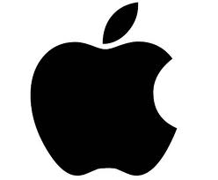
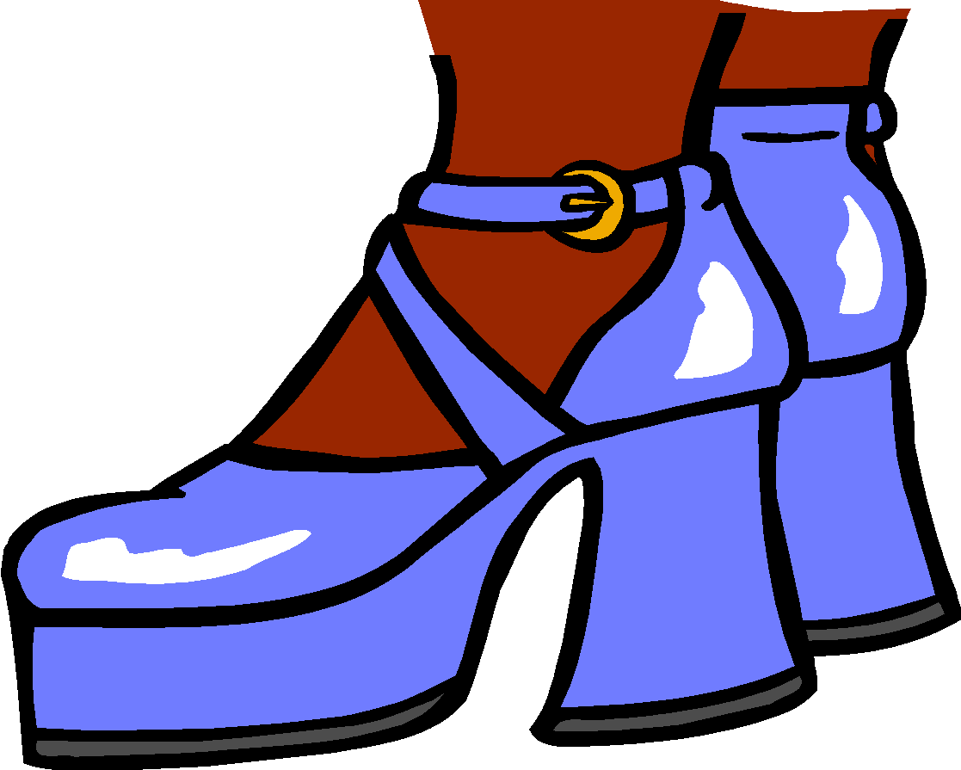
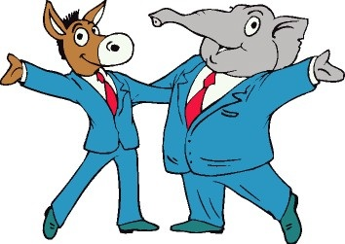

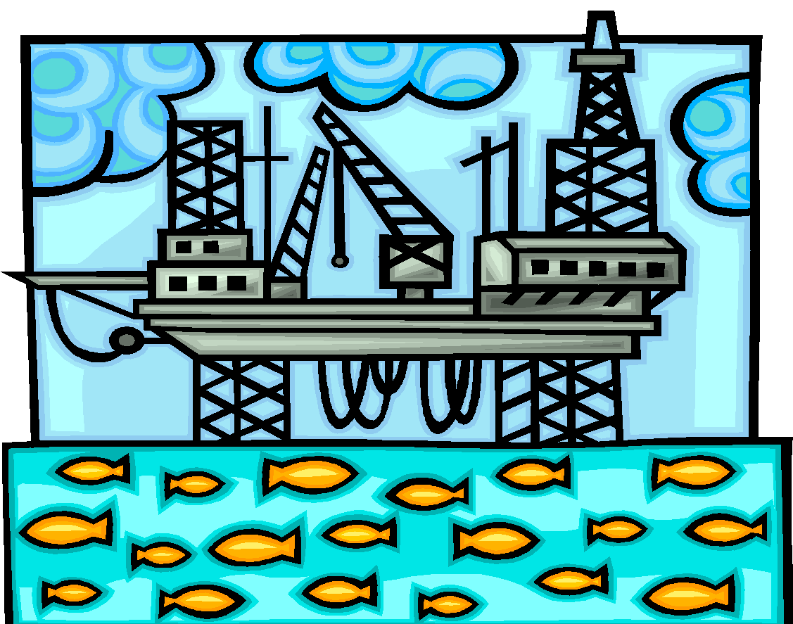
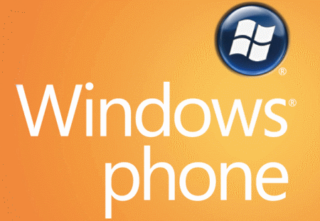
Mobile Platform Considerations
Apple iOS, Android, Windows Phone 7, …

Slide 32
Mobile Platform Considerations
Criterion | Apple iOS | Android | Windows Phone 7
Language | Objective C | Java | Visual Basic
Language Popularity | Low (Difficult) | High | Low
Developer Tools:
Free | No | Yes | Yes
Documentation | Limited | Extensive | Emerging
Open Source | No | Yes | No
App Approval | Strict Oversight | None | Some Oversight
Market Share in 2013 | 19% | 78% | 3%
Hardware Venders | Apple | Many | Many
Mobile Operating System Comparison

Slide 33
WISDM/Actitracker Experiences
Adopted Android because easy to program, easy to deploy, free, open, & multi-vendor
Android was changing quickly when started
Big differences between versions
Many vendors → lots of compatibility testing
Found bugs in some versions but not others
Android little oversight: no problem posting app
WEKA data mining suite written in Java
Now porting Actitracker to iOS

Slide 34
What can we do with the Mobile Sensors?

Slide 35
Let’s think abstractly and not about any specific application. What do sensors tell us?

Slide 36
They provide information about the user
They provide information about the immediate environment

Slide 37
Mostly they tell us about the user.
Mostly they tell us what the user is doing.
This is called activity recognition.
Includes even more if “what” includes “where”.
“Eating at Chipotle” or “running in Central Park”

Slide 38
We will start with activity recognition and how it works. We will cover applications later.
But first, lets look abstractly at what sensor mining can tell us.

Slide 39
What can Sensor Mining Tell Us?
Who is the user?
Biometric identification & identifying traits
What is the user doing?
Activity recognition
Where and When is the user?
Location and spatial based data mining applications
Temporal based data mining applications
Who, What, Where, When, and Why?
Social networking & context sensitive applications
How is the user
Internal health information (heart rate, BP, emotional state, etc.)
Sensing the environment (not user)
Crowdsource weather, group motions (panic), traffic

Slide 40


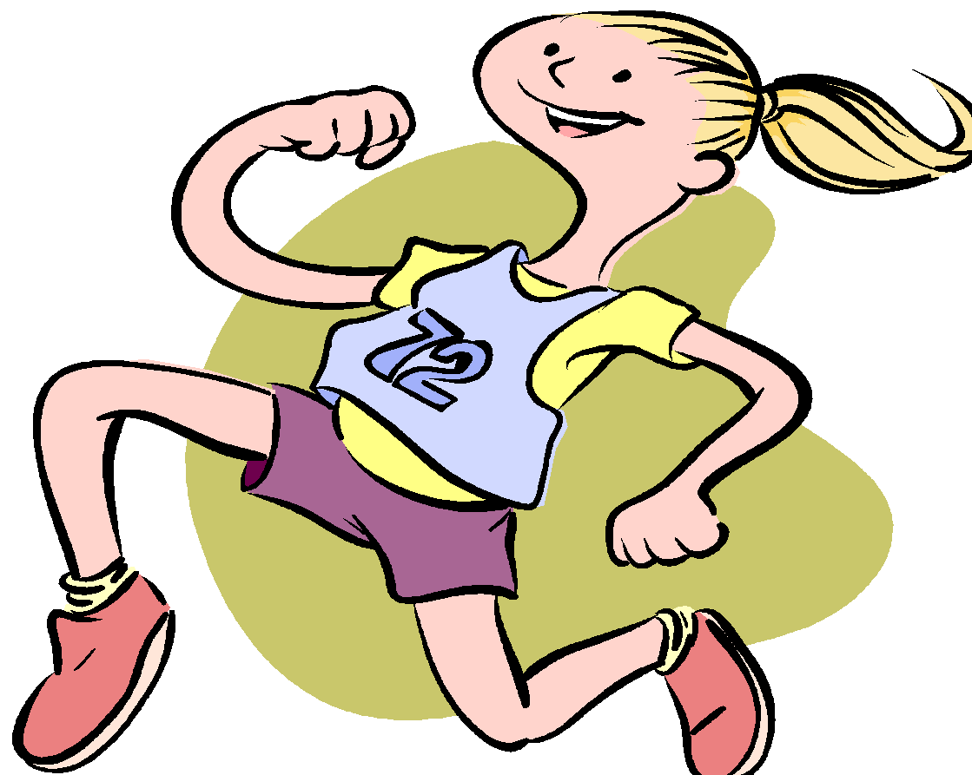

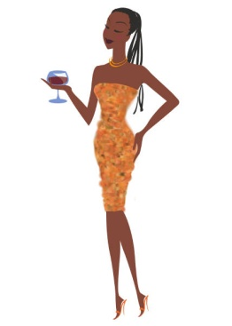
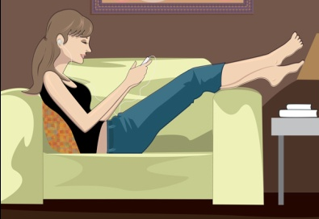
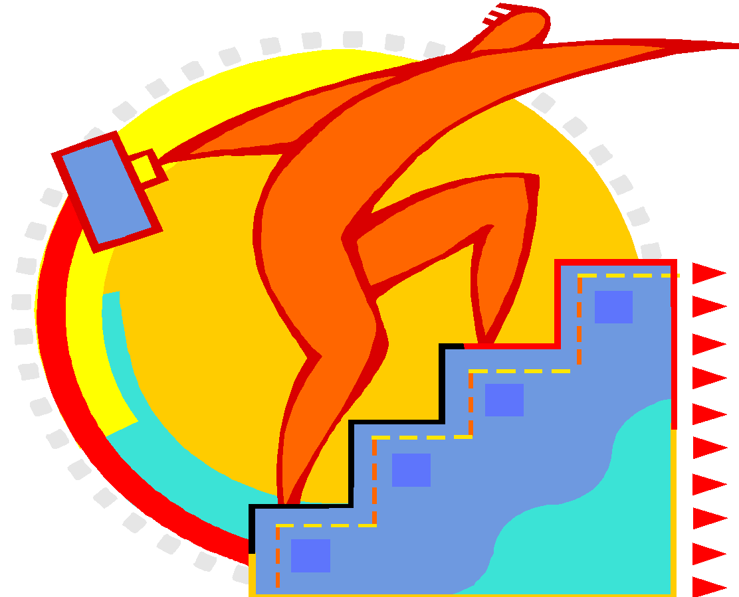
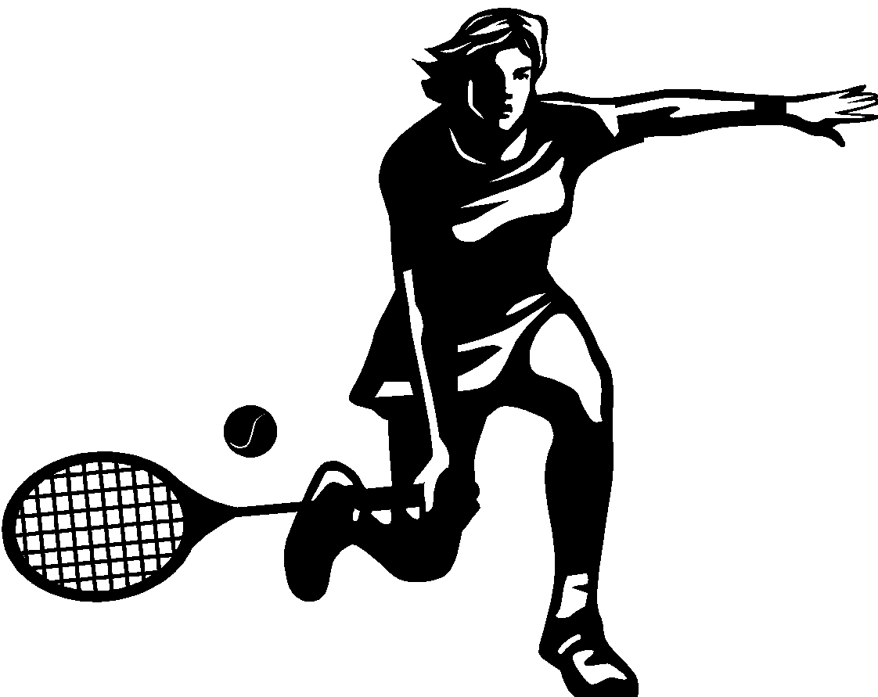
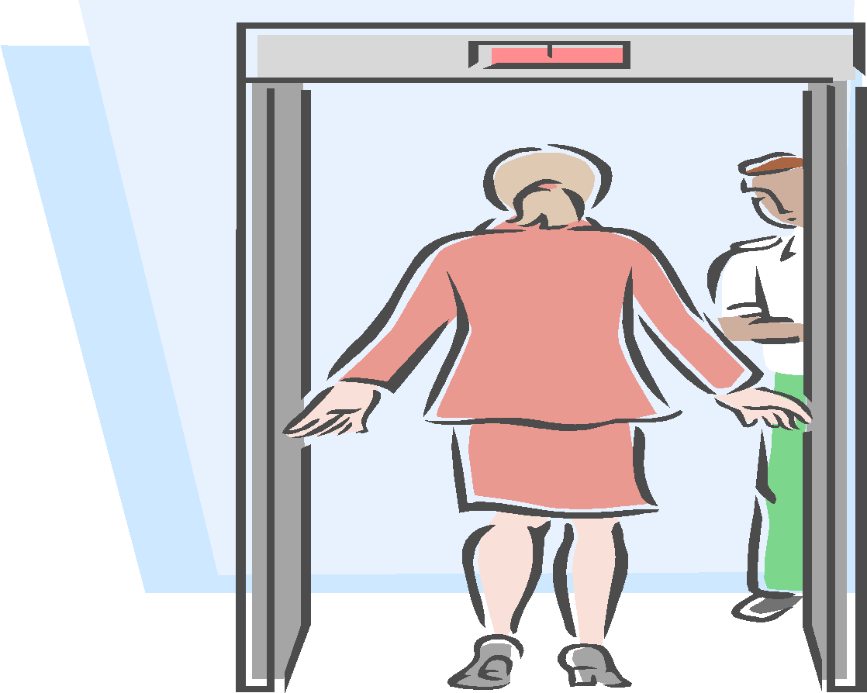

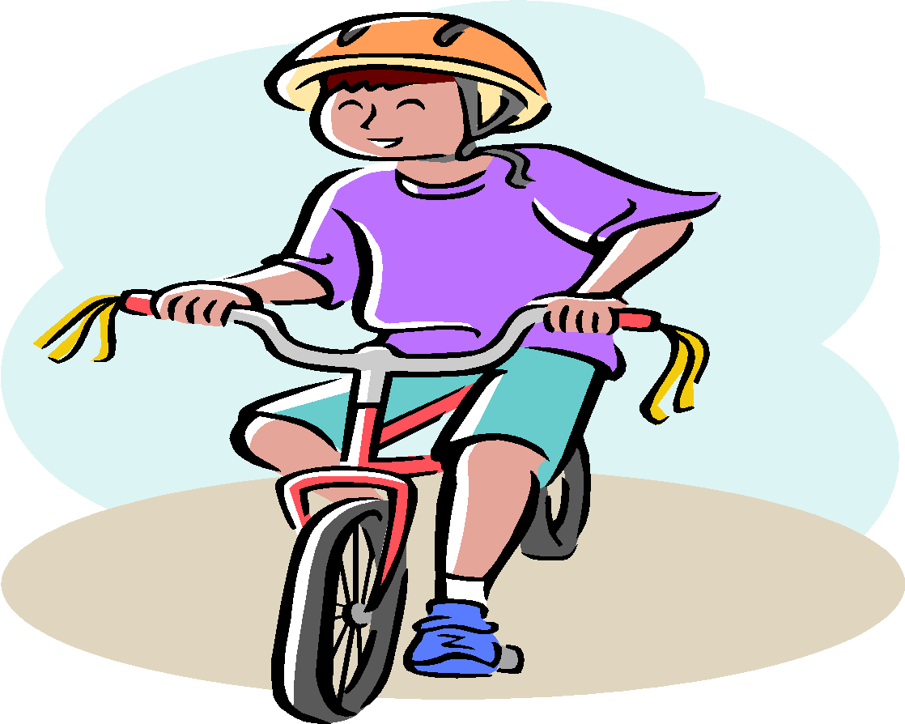
Activity Recognition (AR)

Slide 41
What is Activity Recognition?
Activity recognition identifies user actions
May also attempt to recognize goals
Examples
Walking, jogging, running, jumping, washing dishes, playing basketball, reading, partying, studying
Context may matter
Studying is more likely in a library
Partying occurs in a social environment
CenceMe listens for conversations

Slide 42
Why is Activity Recognition Useful?
Context-sensitive applications
Handle phone calls differently depending on context
Play music to suit your activity
Fuse with other info (GPS) for better results
Can confirm you are on subway vs. traveling in a car¹⁹
Untold new & innovative apps to make phones smarter
Tracking & Health applications
Track overall activity; detect dangerous activity (falling)
Social applications
Link users with similar behaviors (joggers, hunters)
In depth look at applications later

Slide 43
What Devices Can Do AR?
Smartphones, Smartwatches, and Combination
A single accelerometer but custom hardware
Pedometers (limited function); FitBit⁸
Dedicated accelerometers placed on various body parts^{2,13,14,25}
Multi-sensor solutions
eWatch¹⁹: accelometer + light sensor, multiple locs.
Smartbuckle: accelerometer + image sensor on belt
Use Phone but not a central component
Motionbands¹⁰ multi-sensor/location transmits data to smart phone for storage

Slide 44
Data Mining Approach: Doing AR
Collect labeled raw time series sensor data (training data)
Prepare data for mining
Preprocess and transform data
Build classifier using classification algorithms
Deploy and use classifier

Slide 45
Collecting Labeled Activity Data
Laboratory approach
Sequence through a specific set of activities
Insert label into data stream (via app) and then collect sensor data while subject performs activity
Natural approach
Have subject perform activities “in the wild” and label manually afterwards using video capture (or equivalent)
Both methods require time and effort

Slide 46
Self-Training
If desire a personalized activity recognition model, then to be practical user must provide own training data
As we shall see personal models perform best
Similar to laboratory approach but no research assistant
Actitracker app supports self-training and simple for user to provide training data

Slide 47
Feature Extraction
Sensor data is time-series data
Common classification algorithms expect “examples”
Typical approach: extract higher level features using a sliding window & generate fixed length records
Average acceleration per axis, variance, binned distributing, speed from GPS data, etc.
Actitracker uses a 10 second window and no overlap¹⁵
One other study uses ~⁷s window with 50% overlap⁴
Alternative: use time series prediction methods
Few applications actually do this

Slide 48
Generating AR Classifiers
Process to generate classifiers straightforward
Many techniques:
Neural nets, decision trees, Naïve Bayes, Random Forest, etc.

Slide 49
Two Types of Predictive Models
Personal model
Acquire training data for user & then generate model
Places data collection requirement on user, but may sometimes by easily automated
Universal/Impersonal Model
Built on one set of users and applied to everyone else
No requirement on new user– no run-time training
Personal models almost always do significantly better, even using much less training data^{15,16,29}

Slide 50
Deploying AR Classifier
Classifier may run on server
data must be sent to it
Classifier may run on client device
Must be able to handle computational requirements
Simple methods are best
Models can be exported as code and do not need to run under the data mining system

Slide 51
Location on Body of Smart Phone
The location of the smart phone will impact activity recognition
WISDM study currently assumes phone in pocket¹⁵
CenceMe study showed pocket and belt clip yield similar results²¹
Phone in pocket book & elsewhere needs study
Phone orientation can have impact
WISDM study indicates may not be a problem
Can correct for orientation using orientation info
Women are trouble w.r.t. “wearing” phones

Slide 52
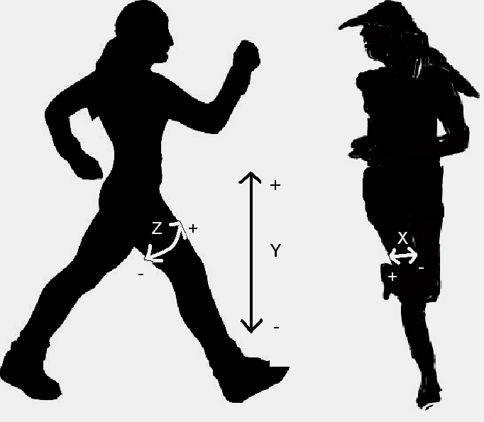
Accelerometer Data for Six Activites
Accelerometer data from Android phone¹⁵
Walking
Jogging
Climbing Stairs
Lying Down
Sitting
Standing

Slide 53
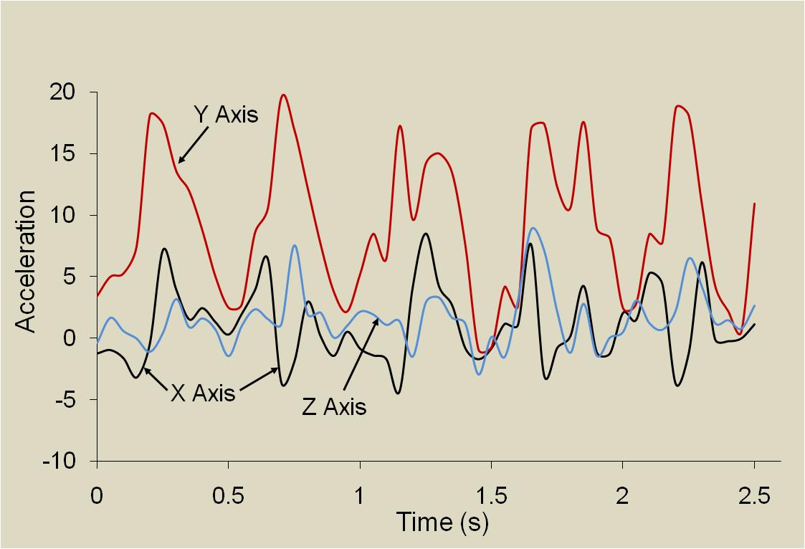
Accelerometer Data for “Walking”

Slide 54
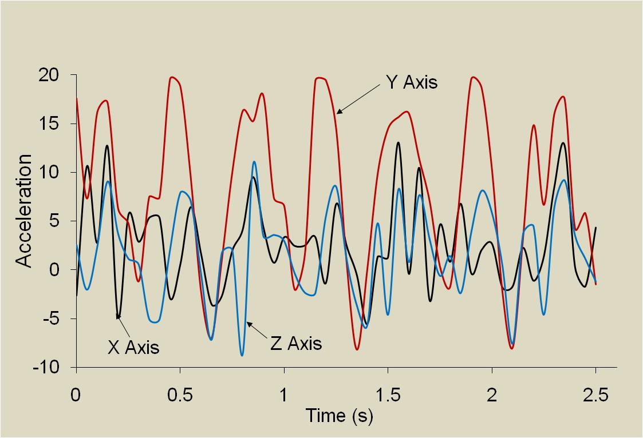
Accelerometer Data for “Jogging”

Slide 55
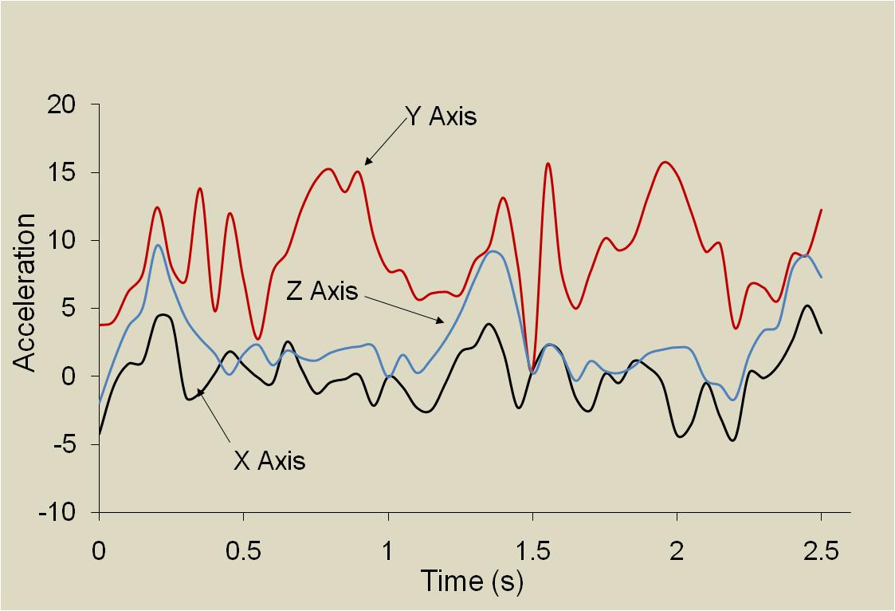
Accelerometer Data for “Up Stairs”

Slide 56
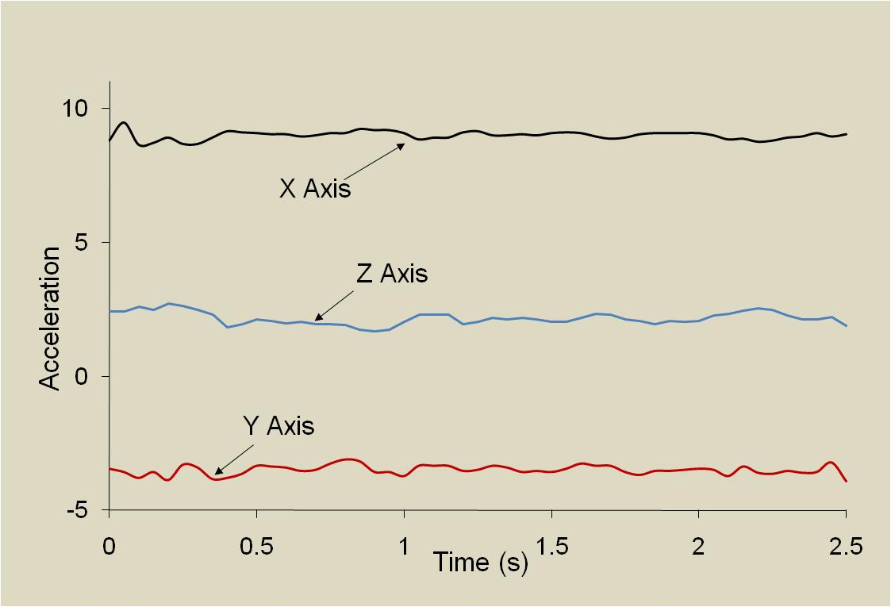
Accelerometer Data for “Lying Down”

Slide 57
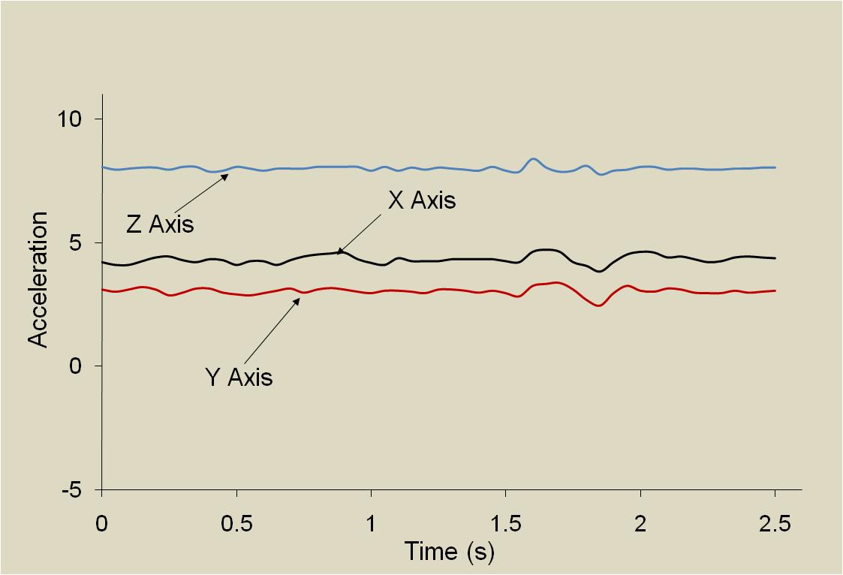
Accelerometer Data for “Sitting”
Z axis

Slide 58
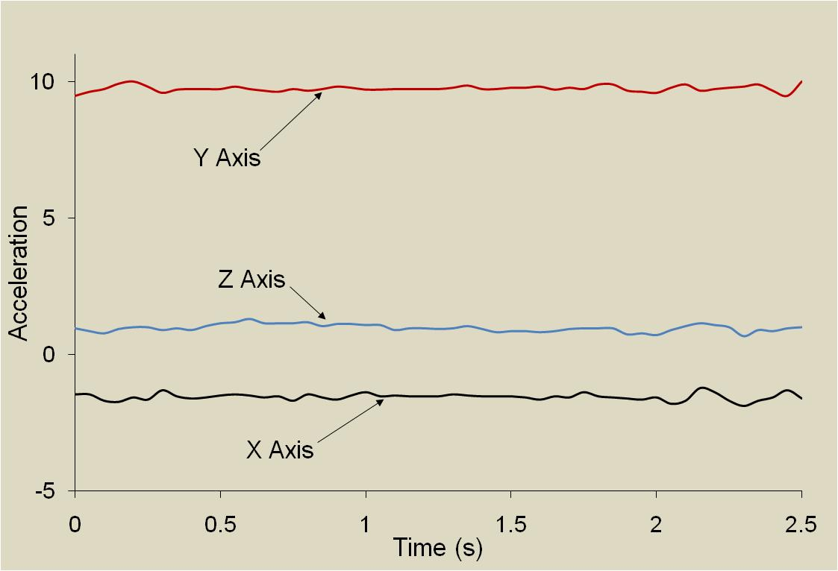
Accelerometer Data for “Standing”

Slide 59
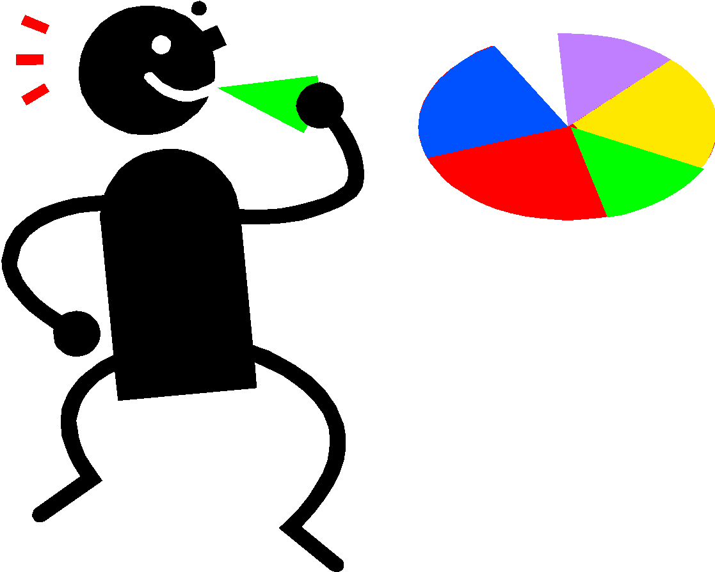
Activity Recognition Results

Slide 60
Different Types of AR Systems
We focus on Smartphone-based AR
Smartwatches mentioned because may become common and important mobile sensors
Future may introduce more such accessories
Clothes and footwear with sensors, etc.
Smart houses and vision-based systems could dramatically expand AR capabilities
We briefly cover laboratory-type systems from the past to show potential

Slide 61
A Non-Phone Based System
Activity Recognition from User-Annotated Acceleration Data²
Accelerometer on 4 limbs & waist, universal model
Activity | Accuracy | Activity | Accuracy
Walking | 89.71 | Walking carrying items | 82.10
Sitting & Relaxing | 94.78 | Working on Computer | 97.49
Standing Still | 95.67 | Eating or Drinking | 88.67
Watching TV | 77.29 | Reading | 91.79
Running | 87.68 | Bicycling | 96.29
Stretching | 41.42 | Strength-training | 82.51
Scrubbing | 81.09 | Vacuuming | 96.41
Folding Laundry | 95.14 | Lying Down & Relaxing | 94.96
Brushing Teeth | 85.27 | Climbing Stairs | 85.61
Riding Elevator | 43.58 | Riding Escalator | 70.56

Slide 62
Non-Phone Based System (cont)
Classifier | Personalized Model | Universal Model
Decision Table | 36.32 | 46.75
Instance-Based | 69.21 | 82.70
C4.5 | 71.58 | 84.26
Naïve Bayes | 34.94 | 52.35
Universal models perform best. The increase in the amount of data more than compensates for the fact that people move differently. This does not appear to be the case for phone based systems with measurements on one body location.

Slide 63
WISDM Activity Recognition¹⁵
Smart-phone based (Android)
Six activities: walking, jogging, stairs, sitting, standing, lying down (more to come)
Labeled data collected from over 50 users
Data transformed via 10-second windows
Accelerometer data sampled (x,y,z) every 50m
Features (per axis):
average, SD, ave diff from mean, ave resultant accel, binned distribution, time between peaks

Slide 64
WISDM Activity Recognition¹⁵
The 43 features used to build a classifier
WEKA data mining suite used, multiple techniques
Personal, universal, hybrid models built
Universal models built using leave-one-out validation
Architecture (for now) uses “dumb” client
Basis of actitracker service (actitracker.com)
Provides view of activities over time

Slide 65
WISDM Activity Recognition Results
WISDM results¹⁵ are presented using:
Confusion matrices and accuracy
Results are shown for various things
Personal, universal, and hybrid models²⁹
Most results aggregated over all users but a few per user to show how performance varies by user
Results for 6 activities (ones shown in the plots)

Slide 66
WISDM Universal Model- IB3 Matrix
72.4% Accuracy |  | Predicted Class
 |  | Walking | Jogging | Stairs | Sitting | Standing | Lying Down
Actual Class | Walking | 2209 | 46 | 789 | 2 | 4 | 0
 | Jogging | 45 | 1656 | 148 | 1 | 0 | 0
 | Stairs | 412 | 54 | 869 | 3 | 1 | 0
 | Sitting | 10 | 0 | 47 | 553 | 30 | 241
 | Standing | 8 | 0 | 57 | 6 | 448 | 3
 | Lying Down | 5 | 1 | 7 | 301 | 13 | 131

Slide 67
WISDM Personal Model- IB3 Matrix
98.4% accuracy |  | Predicted Class
 |  | Walking | Jogging | Stairs | Sitting | Standing | Lying Down
Actual Class | Walking | 3033 | 1 | 24 | 0 | 0 | 0
 | Jogging | 4 | 1788 | 4 | 0 | 0 | 0
 | Stairs | 42 | 4 | 1292 | 1 | 0 | 0
 | Sitting | 0 | 0 | 4 | 870 | 2 | 6
 | Standing | 5 | 0 | 11 | 1 | 509 | 0
 | Lying Down | 4 | 0 | 8 | 7 | 0 | 442

Slide 68
WISDM Hybrid Model- IB3 Matrix
97.1% Accuracy |  | Predicted Class
 |  | Walking | Jogging | Stairs | Sitting | Standing | Lying Down
Actual Class | Walking | 3028 | 2 | 32 | 2 | 2 | 0
 | Jogging | 5 | 1803 | 5 | 1 | 0 | 0
 | Stairs | 86 | 13 | 1288 | 3 | 0 | 0
 | Sitting | 4 | 1 | 6 | 903 | 2 | 24
 | Standing | 2 | 0 | 14 | 1 | 520 | 3
 | Lying Down | 3 | 2 | 5 | 22 | 0 | 421

Slide 69
WISDM AR Accuracy Results
 | % of Records Correctly Classified
 | Personal |  |  | Universal |  |  | Straw Man
 | IB3 | J48 | NN | IB3 | J48 | NN
Walking | 99.2 | 97.5 | 99.1 | 72.4 | 77.3 | 60.6 | 37.7
Jogging | 99.6 | 98.9 | 99.9 | 89.5 | 89.7 | 89.9 | 22.8
Stairs | 96.5 | 91.7 | 98.0 | 64.9 | 56.7 | 67.6 | 16.5
Sitting | 98.6 | 97.6 | 97.7 | 62.8 | 78.0 | 67.6 | 10.9
Standing | 96.8 | 96.4 | 97.3 | 85.8 | 92.0 | 93.6 | 6.4
Lying Down | 95.9 | 95.0 | 96.9 | 28.6 | 26.2 | 60.7 | 5.7
Overall | 98.4 | 96.6 | 98.7 | 72.4 | 74.9 | 71.2 | 37.7

Slide 70
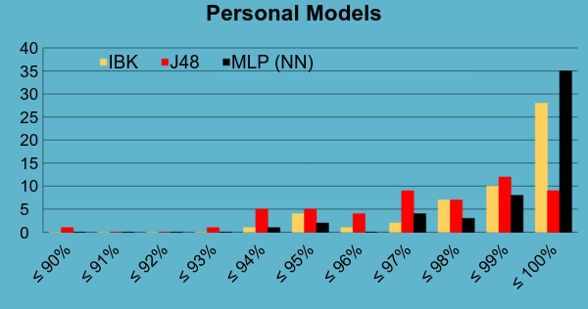
WISDM Per-User Performance

Slide 71
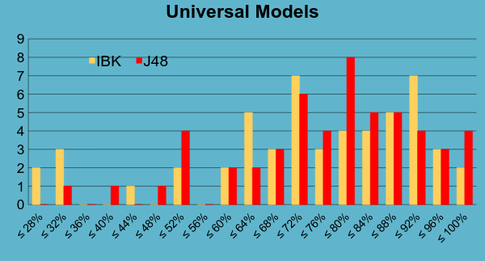
WISDM Per-User Performance

Slide 72
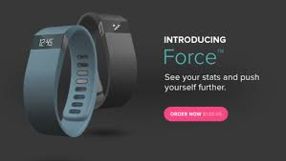
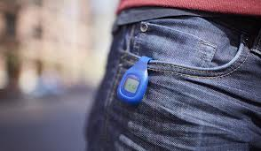
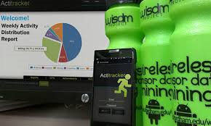
Activity Recognition Applications

Slide 73
AR Application Categories²⁸
Mobile Health (mHealth)
Fitness Tracking
Health Monitoring
Using Context
General Context Aware Behavior
Smart Homes and Work Automation
Self-Managing System

Slide 74
AR Application Categories (cont.)²⁸
Applications for 3rd Parties
Targeted Advertising
Data Collection for Research
Corporate Management and Accounting
Monitor employees and customers (Progressive Insurance)
Applications for Crowds and Groups
Traditional and Activity-based Social Networking
Activity-based Crowdsourcing

Slide 75
Actitracker mHealth Application³⁰
Actitracker is an activity recognition app
Created by my WISDM Lab
Smartphone-based
Currently available for Android but iOS support coming
Simple client sends raw data to server for processing
Tracks walking, jogging, stairs, sitting, standing, lying down
Self-training mode available for improved AR results
Results currently available from web account

Slide 76
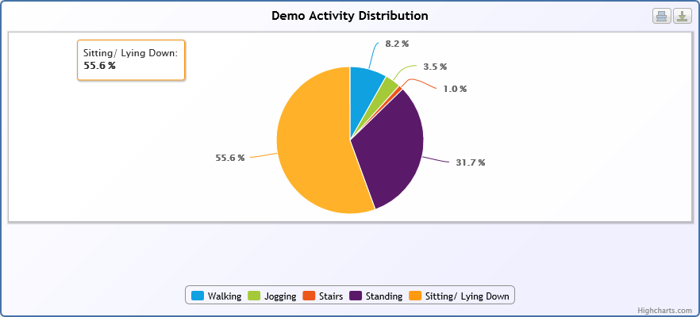
Actitracker Sample Results Distribution of Activities

Slide 77
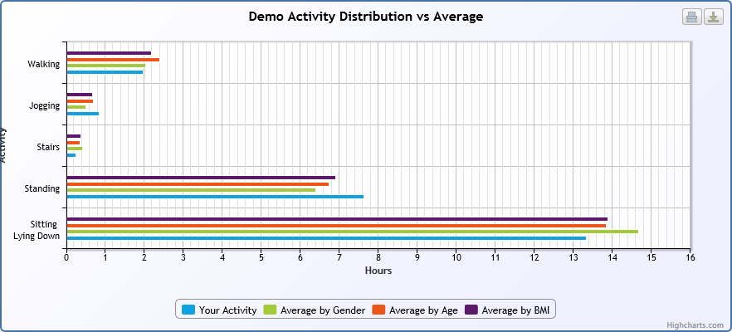
Actitracker Sample Results Comparison with Other Populations

Slide 78
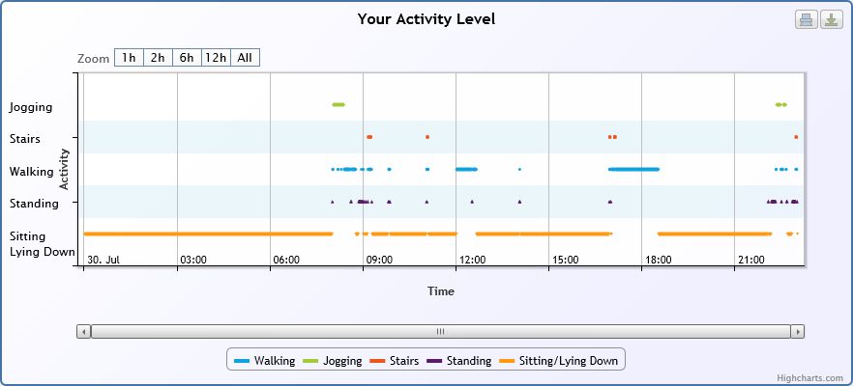
Actitracker Sample Results Comparison with Other Populations

Slide 79
Other Actitracker Results
Actitracker also computes
Calories burned (based on profile info and activities)
FitDex: A custom created numerical summary of activity
Currently working on incorporating results into the client app for more convenient viewing

Slide 80
Actitracker
Available from Google Play
More info from actitracker.com
Activity recognition data sets available
WISDM research data sets
All data is labeled
Actitracker data sets
Mostly unlabeled data (labeled training data)
http://www.cis.fordham.edu/wisdm/dataset.php

Slide 81
FitBit mHealth App
Tracks steps, activity level (low, med, high), calories burned, sleep
Sleep tracking
Tracks total amount of time asleep
Little precision on quality of sleep
Does not seem to work well
Step tracking seems worse than phone apps
Does not permit API access to raw data

Slide 82
EmotionSense
App lets you explore how your smartphone sensor data relates to mood.
Utilizes phone's GPS, accelerometer, and microphone, with a log of the user’s calling and texting patterns.
Users manually enter survey for current mood
General lesson:
Now that we can collect lots of data can correlate with events (e.g., activity and weight loss)

Slide 83
Sleep as Android App
App tracks sleep (place phone on bed)
Duration
Quality (e.g., deep sleep)
Monitors snoring and tries to stop snoring
Annoying sound
Graphs accelerometer, sound, etc.
Can integrate with smartwatch

Slide 84
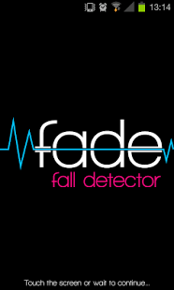
Health Monitoring: Fall Detection
Mainly focused on helping the elderly
Mostly camera & accelerometer based
May also use acoustic or pressure sensors
GE QuietCare: camera-based system (nursing homes)
Accelerometer-based approach ^{11,24,27}
Sensor at waist generally best
Threshold-based mechanism³ (2.5g - 3.5g)
Most data from simulated falls
Smartphone apps exist
Phone can call for help

Slide 85
Health Monitoring: Bad Gait
Gait (walking speed) informally considered 6th vital sign
Work on phone-based gait abnormality detection just beginning
Currently lab environments with pressure pads and expensive equipment
My WISDM Lab is beginning to look into this

Slide 86
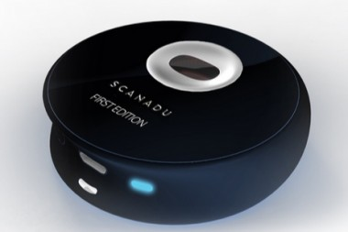
Health Monitoring: with Accessories
AliveCor Heart Monitor
ECG via add-on smartphone case: touch with fingers
IBGStar Blood Glucose Monitoring
Attaches to iPhone
Other accessories send data to smartphone
Blood pressure, breathanalyzer, etc.
Scandu Scout
Separate device sized of hockey puck that you put on your forehead for 10 sec
Measures heart rate, temperature, o₂ saturation, BP, ECG and emotional state

Slide 87
Determining Transportation Modes
Nokia n95 system²³ uses GPS & Accelerometer
GIS info may be missing or mode may be ambiguous
Modes: stationary, walking, running, biking, motorized
Precision & recall both equal 91.3% using a decision tree and 93.6% when using DT combined with HMM
To save power shuts off GPS when inside
Triggers GPS based on change in primary cell phone tower
GPS lock takes a while so even trying it occasionally saps power
Alternatives:
use GPS & GIS info²² or only accelerometer

Slide 88
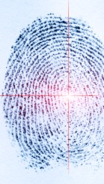
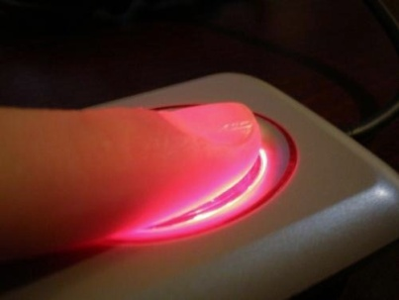
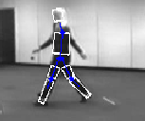
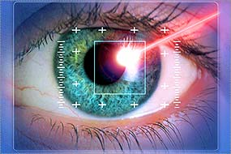
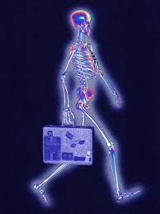
Biometric Identification

Slide 89
Biometrics
Biometrics concerns unique identification based on physical or behavioral traits
Hard biometrics involves traits that are sufficient to uniquely identify a person
Fingerprints, DNA, iris, etc.
Soft biometric traits are not sufficiently distinctive, but may help
Physical traits: Sex, age, height, weight, etc.
Behavioral traits: gait, clothes, travel patterns, etc.

Slide 90
Biometrics for Everyone
Equipment getting smaller, cheaper
Biometrics needs sensors and processing
Laptops have sensors and processing
Face recognition now an option
Smart phones also have sensors & processing!
Camera might be relevant, but so is accelerometer
Substantial work on gait based biometrics
Much of it is vision based since can be used widely
Airports, etc.

Slide 91
Gait-Based Biometrics
Numerous accelerometer-based systems that use dedicated and/or multiple sensors
See related work section of Cell Phone-Based Biometric Identification¹⁶ for details
Uses for phone-based biometric systems
Phone security (e.g., to automatically unlock phone)⁹
Automatic device customization¹⁶
To better track people for shared devices
Perhaps for secondary level of physical security

Slide 92
Using Time Delay Embeddings
System from McGill university⁹
Provides alternative way of extracting features
Used methods from nonlinear time series analysis
Uses fewer than a dozen features
Runs entirely on Android HTC G1 phone
Collected 12-120 seconds of data from 25 people
Results: 100% accuracy!
Video clip from Discovery channel⁷
Shows that can quickly identify a user and use it to unlock phone

Slide 93
WISDM Biometric System
Same setup as WISDM activity recognition
Same data collection, feature extraction, WEKA, …
Used for identification and authentication
36 in initial study but then scaled up past 200
Evaluate single and mixed activities
Evaluate using 10 sec. and several min. of test data
Longer sample classify with “Most Frequent Prediction”

Slide 94
WISDM Biometric Prediction Results
 | Aggregate | Walk | Jog | Up | Down | Aggregate (Oracle)
J48 | 72.2 | 84.0 | 83.0 | 65.8 | 61.0 | 76.1
Neural Net | 69.5 | 90.9 | 92.2 | 63.3 | 54.5 | 78.6
Straw Man | 4.3 | 4.2 | 5.0 | 6.5 | 4.7 | 4.3
Based on 10 second test samples
 | Aggregate | Walk | Jog | Up | Down | Aggregate (Oracle)
J48 | 36/36 | 36/36 | 31/32 | 31/31 | 28/31 | 36/36
Neural Net | 36/36 | 36/36 | 32/32 | 28.5/31 | 25/31 | 36/36
Based on most frequent prediction for 5-10 minutes of data

Slide 95
WISDM Biometric Authentication Results
Authentication results:
Positive authentication of a user
10 second sample: ~85%
Most frequent class over 5-10 min: 100%
Negative Authentication of a user (an imposter)
10 second sample: ~96%
Most frequent class over 5-10 min: 100%
Near perfect results extend for unpublished results with 200 subjects (for id and authent.)

Slide 96
Soft Biometrics and User Traits
Soft biometrics traits are not distinctive enough for identification unless combined with other traits
Sex, height, weight, …
But do we have better uses for these “soft” traits than for identification?
As data miners, of course we do!
We want to know everything we possibly can about a person. Somehow we will exploit this.
We could use weight to improve calories burned

Slide 97
Expanding the Definition of Trait
Normally think about traits as being:
Unchanging: race, skin color, eye color, etc.
Slow changing: Height, weight, etc.
But want to know everything about a person:
What they wear, how they feel, if they are tired, etc.
I have not seen this goal stated in context of mobile sensor data mining
It is the focus of Identifying user traits by mining smart phone accelerometer data²⁶

Slide 98
WISDM Trait Identification²⁶
Data collected from ~70 people
Accelerometer and survey data
Survey data includes anything we could think of that might somehow be predictable
Sex, height, weight, age, race, handedness, disability
Type of area grew up in {rural, suburban, urban}
Shoe size, footwear type, size of heels, type of clothing
# hours academic work , # hours exercise
Too few subjects investigate all factors
Many were not predictable (maybe with more data)

Slide 99
WISDM Trait Identification Results
Accuracy 71.2% | Male | Female
Male | 31 | 7
Female | 12 | 16
Accuracy 83.3% | Short | Tall
Short | 15 | 5
Tall | 2 | 20
Accuracy 78.9% | Light | Heavy
Light | 13 | 7
Heavy | 2 | 17
Results for IB3 classifier. For height and weight middle categories removed.

Slide 100
Trait Identification Summary
A wide open area for data mining research
A marketers dream
Clear privacy issues
Room for creativity & insight for finding traits
Probably many interesting commercial and research applications
Imagine diagnosing back problems via your mobile phone via gait analysis …

Slide 101
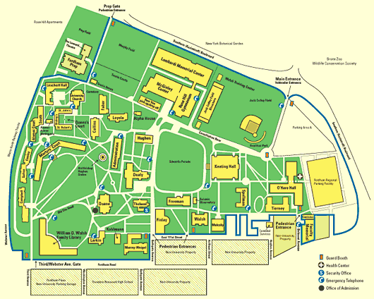
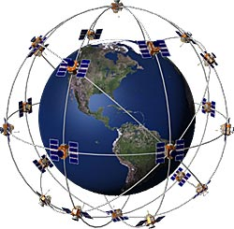
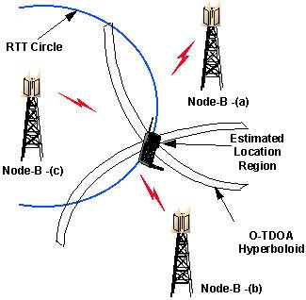
Location-Based Applications

Slide 102
Significant Locations
Significant locations are important locations
Usually defined based on frequency with which one person or a population visits a location
Extract locations where people stay and then cluster them to merge similar points
Stay points: points a user has spent more than ThresTime in within ThresDistance of the point¹²
Interesting locations: locations that include stay points from many (>ThresCount) people

Slide 103
Significant Location System¹²
Data collected from 165 users over 2 years
62 users contains 3.5M GPS points
ThresTime = 20 min and ThresDistance = 0.2 KM
Allows us to ignore most cases where sitting in traffic
User | # GPS Points | # Stay Points | # Interesting Locations Visited
User 1 | 910,147 | 469 | 9
User 2 | 860,635 | 181 | 8
User 3 | 753,678 | 134 | 13
User 4 | 188,480 | 82 | 4
User 5 | 89,145 | 8 | 1

Slide 104
Significant Location System¹²
Table below holds top most interesting places
Results show that subjects are highly educated
Can characterize and group people by the interesting places that they visit
Latitude | Longitude | Frequency | Interesting Locations
40.00 | 116.327 | 309 | Main Building, Tshingua Univ.
39.976 | 116.331 | 122 | China Sigma Center, Microsoft China R&D
40.01 | 116.315 | 74 | Da Yi Tea Culture Center, Tea House
39.975 | 116.331 | 58 | Cuigong Hotel
39.985 | 116.32 | 36 | Loongson Technology Service Center

Slide 105
Significant Locations: Assoc. Rules
Locations visited in a day can represent itemset
Mary: {Supermarket, Park, Post Office, School}
John: {Supermarket, Park, School, McDonald’s}
Rule: {Supermarket, Park} → {School}

Slide 106
Improving Transportation
Use location data from many users (crowdsource)
Avoid congested roads: Google Navigator
Manage traffic dispersion
Mine historical data to predict traffic patterns

Slide 107
Role of Location in Social Networks
Build Social Communities based on location
Proximity
Time
Frequency
Google Latitude
“See where friends are and what they are up to”
Facebook “Check-Ins”
“Check-In” to a certain location using a cell phone, created by a Facebook user, tag friends
See who else is in this location

Slide 108
A Mining Safety Application¹
Heavy equipment in mining is dangerous
Collisions, open pits, bad visibility
Tend to move fast when moving between areas
Existing systems use GPS for collision avoidance
So lots of GPS data
Goal is to use GPS data to improve mine safety
Risk assessment & operator guidance
Beyond immediate collision warnings
Collision avoidance may not be effective if context ignored

Slide 109
A Mining Safety Application (cont.)
Situational awareness– context matters
Dependent on location within mine & activity
Example: main excavation site being loaded with ore
Don’t alarm when a vehicle loads or unloads another
Helps to have knowledge of significant places
Care about places where vehicle interactions differ
Haulage roads, intersections, loading bays, parking lots
Here length of stay not used to determine significant place
Once determine type of places can link/fuse on map

Slide 110
A Mining Safety Application (cont.)
Speed is critical & significant places classified as high or low speed
High speed: haulage roads and (high interaction) intersections
Low speed: dumping, parking, etc. where vehicles tend to bunch up
Crowdsourcing since data from all vehicles
Know type of vehicle and speeds
so have good idea where loading, hauling etc occurs
Can identify normal mining functions
Can identify normal characteristics (speed, closeness, etc.)

Slide 111
Integration with Other Info/Apps
Learn more about locations using other info
Activity impacts location
walk/jog in park
drive on roads
sleep in hotel/house
Demographics impacts location
High schools have lots of teenagers
May know age from some phone apps
All of this works in other direction too
Location impacts activity, tells us something about those at the site

Slide 112
Some Location-Based Apps
iMapMy* where * = {Run, Walk, Ride, Hike}
tracks route, distance, pace, & more in real-time
Share the details of your fitness activities with friends & family, via email, Facebook, or Twitter
This data can be mined for exercise-related info
WHERE helps you discover & share favorite places
Recommendation engine learns your preferences and recommends great places
Create lists of your favorite places and share with friends

Slide 113
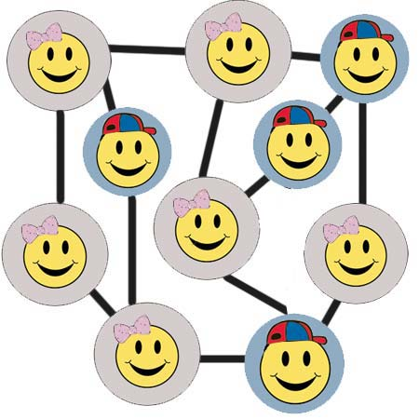
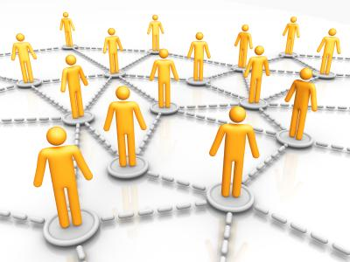
Social Networking Applications

Slide 114
CenceMe Research Application
Sensing meets mobile sensor networks²¹
Classifiers:
Audio classifier uses microphone to determine if human voice is present (based on frequency)
Conversation classifier uses this info to identify a conversation (human voice must exceed threshold)
> 8⁵% accuracy in noisy indoor environments
Activity classifier (DT) uses accelerometer and determines sitting, standing, walking, running

Slide 115
CenceMe Application
Social context classifier derived from multiple sources
Neighborhood info: CenceMe buddies around?
Social status: uses conversation & activity classifier
Can tell if talking to buddies at a restaurant, alone, or at a party
Partying and dancing are social status states that use activity and sound volume (volume used to identify parties)
Mobility mode detector uses GPS to determine if in a vehicle or not (standing, walking, running)
Location classifier uses GIS info and (shared) user created bindings to map to a icon and location type

Slide 116
CenceMe Application
Summarize info by using social stereotypes or behavior patterns, calculated daily and viewable
Nerdy: based on being alone, lots of time in libraries, and few conversations
Party Animal: frequency & duration of parties, level of social interaction
Cultured: frequency & duration of visits to museums, theatre
Healthy: physically active (walking, jogging, cycling)
Greeny: low environmental impact (walk not drive)

Slide 117
CenceMe Application
Based on user study of 22 people over 3 weeks the things people liked the most:
Location information
Activity & conversation information
Social context
Random images
When your phone is open the phone takes & posts pics
People like it because it forms a daily diary
“Oh yeah … that chair … I was in classroom 112 at 2PM”

Slide 118
CenceMe Application
One survey comment was:
“CenceMe made me realize I’m lazier than I thought and encouraged me to exercise a bit more”

Slide 119
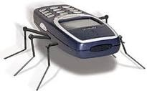
Security & Privacy

Slide 120
Security and Privacy
Security policies vary widely
Some mobile OS’s have strict security policies
Symbian requires properly signed keys to remove restrictions on using certain APIs
Android has few restrictions
Android security focuses on sandboxing apps, not on restricting access to device APIs
My WISDM project has had no problem tapping into sensors and transmitting results
Android does notify the user of services that are used
SYSTEM PERMISSIONS FOR WISDM SensorCollector
ACCESS_COARSE_LOCATION, ACCESS_FINE_LOCATION
INTERNET, WAKE_LOCK, WRITE_EXTERNAL_STORAGE

Slide 121
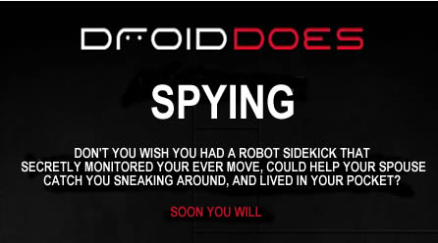
Security and Privacy
Applications that access sensor data can easily spy on you (they do by design)
Location data is probably most sensitive
A few bad apps could damage the field
Dozens of spy apps exist, often masquerading as “parental control” apps
Note below from http://www.androidspysoftware.com

Slide 122
Security and Privacy
Even legitimate applications have to be concerned with privacy & security
For example, WISDM will encrypt data in transit, include secure accounts with passwords, etc.
Need to ensure than any aggregated info is made public only if cannot be traced to individual
As research study WISDM needs to be careful
Do we want others to know where we are 24x7, when we are active, asleep, etc?

Slide 123
Security and Privacy
What to do?
Make it clear what you are monitoring and storing
Provide application level control for the user
For example, allow the users to turn on/off monitoring of specific sensors and show which ones are on
Of course if they use an option to upload the information to Facebook then little privacy!
Since legitimate and illegitimate apps function alike, no easy way to distinguish them
Could try to use only certified apps, but quite limiting

Slide 124
Security & Privacy: iPhone Controversy
Why is my iPhone logging my location? The iPhone is not logging your location. Rather, it’s maintaining a database of Wi-Fi hotspots and cell towers around your current location, some of which may be located more than one hundred miles away from your iPhone, to help your iPhone rapidly and accurately calculate its location when requested. Calculating a phone’s location using just GPS satellite data can take up to several minutes. iPhone can reduce this time to just a few seconds by using Wi-Fi hotspot and cell tower data to quickly find GPS satellites, and even triangulate its location using just Wi-Fi hotspot and cell tower data when GPS is not available (such as indoors or in basements). These calculations are performed live on the iPhone using a crowd-sourced database of Wi-Fi hotspot and cell tower data that is generated by tens of millions of iPhones sending the geo-tagged locations of nearby Wi-Fi hotspots and cell towers in an anonymous and encrypted form to Apple.

Slide 125
Security & Privacy: iPhone Controversy
People have identified up to a year’s worth of location data being stored on the iPhone. Why does my iPhone need so much data in order to assist it in finding my location today? This data is not the iPhone’s location data—it is a subset (cache) of the crowd-sourced Wi-Fi hotspot and cell tower database … to assist the iPhone in rapidly and accurately calculating location. The reason the iPhone stores so much data is a bug we uncovered and plan to fix shortly. We don’t think the iPhone needs to store more than seven days of this data.
When I turn off Location Services, why does my iPhone sometimes continue updating its Wi-Fi and cell tower data from Apple’s crowd-sourced database? It shouldn’t. This is a bug, which we plan to fix shortly.

Slide 126
Future of Sensor Security
New sensors bring about new security concerns
Fingerprint Scanning as Authentication
iPhone 5s and Galaxy S5
Can be fooled
Create wood glue replica from latent print (maybe created by taking a picture)
Apps that utilize new sensors need to be upfront in how and why they access sensors
More data means more exposure for the end user

Slide 127
My Contact Information
Gary Weiss
Fordham University, Bronx NY 10458
gaweiss@fordham.edu
http://storm.cis.fordham.edu/~gweiss/
WISDM Information
http://www.cis.fordham.edu/wisdm/
WISDM papers available: click “About” then “Publications”
Actitracker allows you to track your activities
actitracker.com or Google Play “Actitracker”

Slide 128
Special Thanks To …
WISDM research group
Current Members
Andrew Johnston, Tausif Hasan, Jeff Lockhart, Luigi Patruno, Tony Pulickal, Greg Rigatti, Isaac Ronan, Jessica Timko
Key Former Members
Shaun Gallagher, Andrew Grosner, Jennifer Kwapisz, Paul McHugh, Sam Moore, Shane Skowron, Alvan Wong, Jack Xue
Key Funders:
US National Science Foundation, Google, and Fordham University

Slide 129
These slides available from: http://storm.cis.fordham.edu/~gweiss/presentations.html

Slide 130
References
Agamennoni, G., Nieto, J., and Nebot, E. 2009. Mining GPS data for extracting significant places, Proceedings of the 2009 IEEE international conference on Robotics and Automation.
Bao, L. and Intille, S.. 2004. Activity recognition from user-annotated acceleration data, Lecture Notes Computer Science, vol. 3001, pp. 1-17.
Bourke, A.K., O'Brien, J.V., and Lyons, G.M. 2007. Evaluation of threshold-based tri-axial accelerometer fall detection algorithm, Gait & Posture 26(2): 194-99.
Bouten, C.V., Koekkoek, K.T., Verduin, M., Kodde, R., and Janssen, J.D. 1997. A triaxial accelerometer and portable data processing unit for the assessment of daily physical activity, IEEE Transactions on Bio-Medical Engineering, 44(3):136-147.
Brezmes, T., Rersa, M., Gorricho, J-L, and Cotrina, J. 2010. Surveillance with Alert Management System using Conventional Cell Phones, Proceedings of the 5th International Multi-Conference on Computing in the Global Information Technology, 121-125.
Cho, Y., Nam, Y., Choi, Y-J, and Cho, W-D. 2008,.Smart-Buckle: human activity recognition using a 3-axis accelerometer and a wearable camera, HealthNet.
Discovery channel video about a Smart phone-based biometric system for securing smart phones (based on the research in X16). The relevant portion is about 2/3 thru the video clip which contains two segments. Url: http://watch.discoverychannel.ca/#clip370449

Slide 131
References
FitBit. http://www.fitbit.com
Frank, J., Mannor, S., and Precup, D. 2010. Activity and gait recognition with time-delay embeddings, Proceedings of the 24th AAAI Conference on Artificial Intelligence.
Gyorbiro, N., Fabian, A., and Homanyi, G. 2008. An activity recognition system for mobile phones, Mobile Networks and Applications, 14 (1), 82-91.
Ketabdar, H., and Polzehl., T. 2009. Fall and emergency detection with mobile phones, Assets '09 Proc. of the 11th International ACM SIGACCESS Conference on Computers and Accessibility ACM, 241-42.
Khetarpaul, S., Chaujan, R., Gupta, S.K., Subramaniam, L.V., and Nambiar, U. 2011. Mining GPS data to determine interesting locations, Proceedings of the 8th International Workshop on Information Integration on the Web.
Krishnan, N., Colbry, D., Juillard, C., and Panchanathan, S. 2008. Real time human activity recognition using tri-Axial accelerometers, In Sensors, Signals and Information Processing Workshop.
Krishnan, N., and Panchanathan, S. 2008. Analysis of low resolution accelerometer data for continuous human activity recognition, in IEEE Int. Conf. on Acoustics, Speech and Signal Processing, pp. 3337-3340.
Kwapisz, J.R., Weiss, G.M., and Moore, S.A. 2010. Activity recognition using cell phone accelerometers, Proceedings of the Fourth International Workshop on Knowledge Discovery from Sensor Data, 10-18.

Slide 132
References
Kwapisz, J.R.,Weiss, G.M., and Moore, S.A. 2010. Cell phone-based biometric identification, Proceedings of the IEEE Fourth International Conference on Biometrics: Theory, Applications and Systems.
Li, K.A., Sohn, T.Y., Huang, S, and Griswold, W.G. 2008. PeopleTones: A System for the detection and notification of buddy proximity on mobile phones, Proceedings of the 6th International Conference on Mobile Systems.
Lockhart, J.W., Weiss, G.M., Xue, J.C., Gallagher, S.T., Grosner, A.B., and Pulickal, T.T. 2011. Design considerations for the WISDM smart phone-based sensor mining architecture, In Proceedings of the Fifth International Workshop on Knowledge Discovery from Sensor Data, San Diego, CA.
Maurer, U., Smailagic, A., Siewiorek, D., and Deisher, M. 2006. Activity recognition and monitoring using multiple sensors on different body positions, In IEEE Proceedings on the International Workshop on Wearable and Implantable Sensor Networks, 30(5).
Menn, J. February 8, 2011. Smartphone shipments surpass PCs. Retrieved from http://www.ft.com/cms/s/2/d96e3bd8-33ca-11e0-b1ed-00144feabdc0.html#axzz1L2wKclC7
Miluzzo, E., Lane, N.D., Fodor, K, Peterson, R., Lu, H., Musolesi, M., Eisenman, S.B., Zheng, X., and Campbell, A.T. 2008. Sensing meets mobile social networks: the design, implementation and evlauation of the CenceMe application, Proceedings of the 6th ACM on Embedded Network Sensor Systems, 337-350.

Slide 133
References
Patterson, D., Liao, L., Fox, D, and Kautz, H. 2003. Inferring high-level behavior from low-level sensors. Lecture Notes in Computer Science, Springer-Verlag, 73-89.
Reddy, S. Mun, M. Burke, J. Estrin, D, Hansen, M. and Srivastava, M. 2010. Using mobile phones to determine transportation modes. ACM Transaction on Sensor Networks, 6(2).
Sposaro, F., and Tyson, G. 2009. iFall: An android application for fall monitoring and response, 31st Annual International Conference of the IEEE Engineering in Medicine and Biology Society.
Tapia, E.M., Intille, S. et al. 2007. Real-Time recognition of physical activities and their intensities using wireless accelerometers and a heart rate monitor, In Proc. of the 2007 11th IEEE International Symposium on Wearable Computers.
Weiss, G.M., and Lockhart, J.W. 2011. Identifying user traits by mining smart phone accelerometer data, Proceedings of the 5th International Workshop on Knowledge Discovery from Sensor Data.
Zhang, T., Wang, J., Liu, P., and Hou, J. 2006. Fall detection by embedding an accelerometer in cellphone and using KFD algorithm, International Journal of Computer Science and Network Security, 6(10): 277-284.
Lockhart, J.W., Pulickal, T., and Weiss, G.M. 2012. Applications of mobile activity recognition. In Proceedings of the ACM Ubicomp International Workshop on Situation, Activity, and Goal Awareness, Pittsburgh, PA.
Lockhart, J.W., Weiss, G.M. The Benefits of Personalized Models for Smartphone-Based Activity Recognition, Proceedings of the 2014 SIAM International Conference on Data Mining, Society for Industrial and Applied Mathematics, Philadelphia, PA, 614-622.
Weiss, G.M., Lockhart, J.W., Pulickal, T.T., McHugh, P., Ronan, I.H., Timko, J.L. Actitracker: A Smartphone-based Activity Recognition System for Improving Health and Well-Being, working paper.

